Slide 1
POLITICAL HISTORY OF BENGAL UP TO THE ADVENT OF THE BRITISH IN INDIA
IIT-1212 Bangladesh Studies

Slide 2
Naming of Bengal
The exact origin of the word Bangla is unknown, though it is believed to be derived from the Dravidian-speaking tribe Bang/Banga that settled in the area around the year 1000 BCE.
Other accounts speculate that the name is derived from Venga (Bongo), which came from the Austric word "Bonga" meaning the Sun-god.
According to the Mahabharata, the Puranas and the Harivamsha, Vanga was one of the adopted sons of King Vali who founded the Vanga Kingdom.
The earliest reference to "Vangala" (Bôngal) has been traced in the Nesari plates (805 CE) of Rashtrakuta Govinda III which speak of Dharmapala as the king of Vangala.

Slide 3
The records of Rajendra Chola I of the Chola dynasty, who invaded Bengal in the 11th century, use the term Vangaladesa.
The term Bangalah is one of the precursors to the modern terms Bengal and Bangla. Bangalah was the most widely used term for Bengal during the medieval and early modern periods. The Sultan of Bengal was styled as the Shah of Bangalah. The Mughal province of Bengal was termed Subah-i-Bangalah.
An interesting theory of the origin of the name is provided by Abu'l-Fazl in his Ain-i-Akbari. According to him, "The original name of Bengal was Bung, and the suffix "al" came to be added to it from the fact that the ancient rajahs of this land raised mounds of earth 10 feet high and 20 in breadth in lowlands at the foot of the hills which were called "al". From this suffix added to the Bung, the name Bengal arose and gained currency".

Slide 4
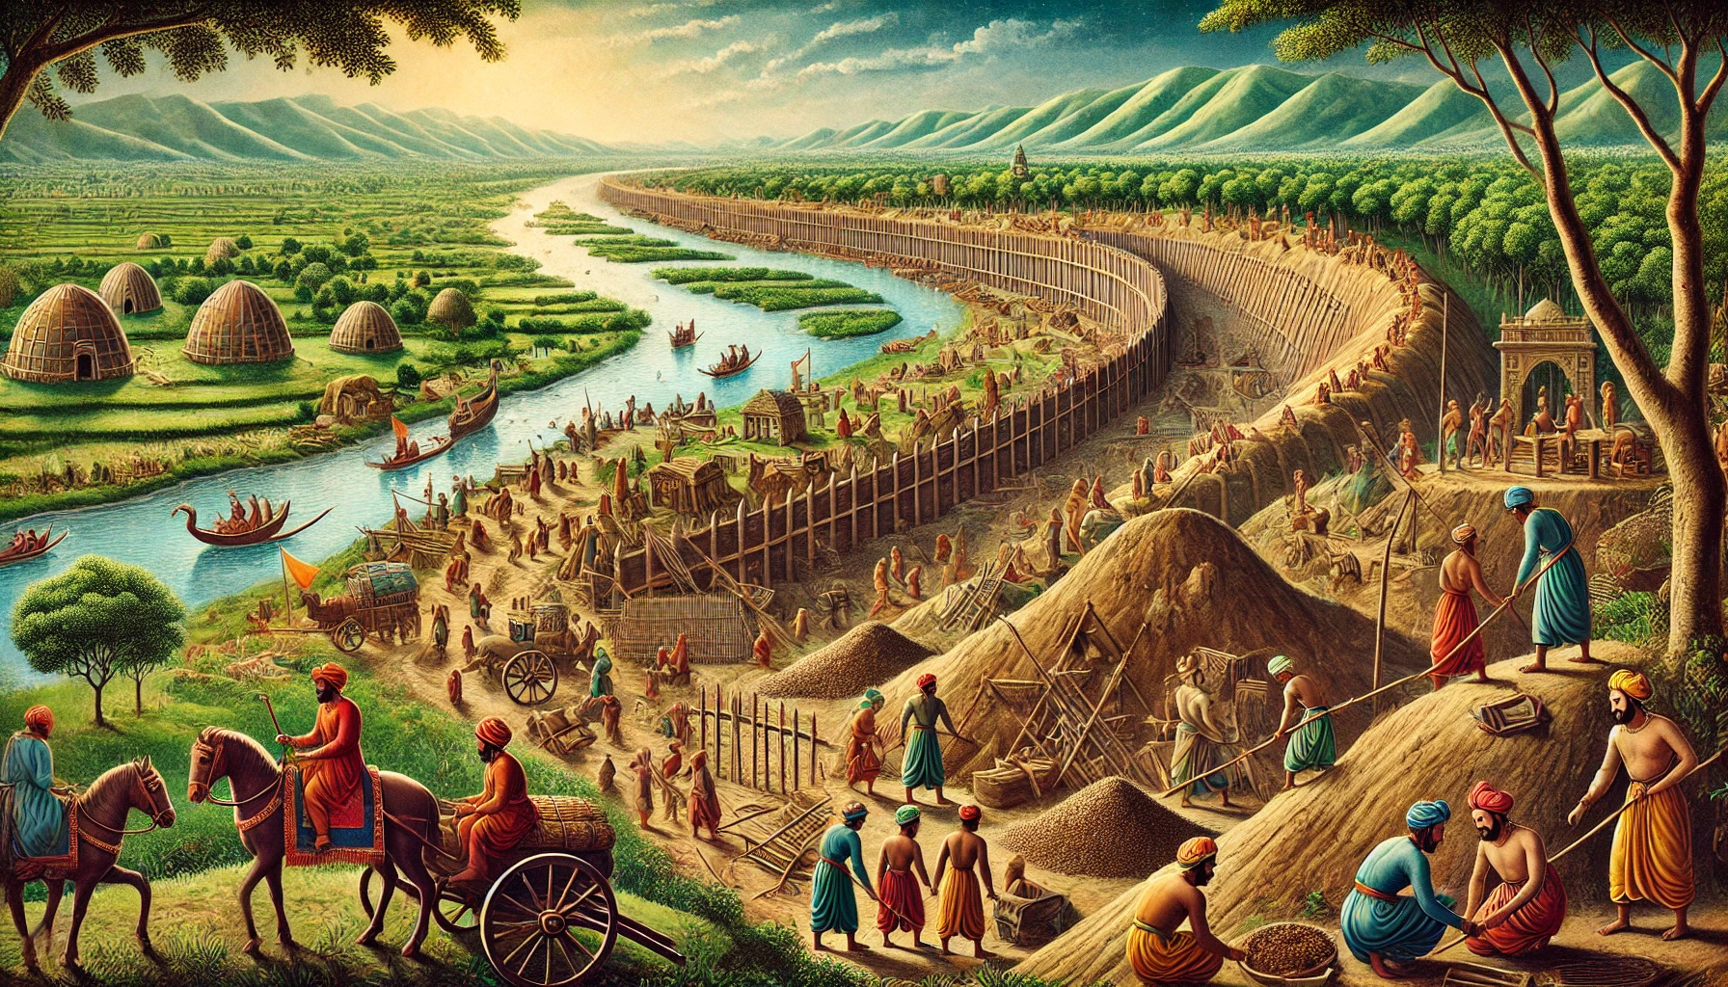

Slide 5
Early Settlement
Stone Age tools found in the region indicate human habitation for over 20,000 years.
Archaeological evidence confirms that by the second millennium BCE, the Bengal delta was inhabited by rice-cultivating communities.
Explorations and excavations in the region brought into light 479 sites pertaining to the Palaeolithic (100), Mesolithic (208), Neolithic (99) and Proto-historic/Chalcolithic (72) periods. Of these, three Mesolithic, one Neolithic and 11 Chalcolithic sites so far have been excavated.
Bengal was settled by Austroasiatics, Tibeto-Burmans, Dravidians and Indo-Aryans in consecutive waves of migration.
Rivers such as the Ganges and Brahmaputra were used for transport while maritime trade flourished in the Bay of Bengal.
Alexander Cunningham, the founder of the Archaeological Survey of India, identified the archaeological site of Mahasthangarh as the capital of the Pundra Kingdom mentioned in the Rigveda.

Slide 6
Early literary, Epigraphic and Geographic accounts
The ancient Bengal region features prominently in legendary history of India, Sri Lanka, Siam, Indonesia, Cambodia, Burma, Nepal, Tibet, China.
According to the Indian epic Mahabharata, the Vanga Kingdom was located in Eastern India.
According to Sri Lankan history, the first king of Sri Lanka was Prince Vijaya who led a fleet from India to conquer the island of Lanka. Prince Vijaya's ancestral home was Bengal.

Slide 7
In the Greco-Roman world, accounts of the Gangaridai Kingdom are considered by historians to have referred to Bengal. At the time of Alexander the Great's invasion of India, the collective might of the Gangaridai and the Nanda Empire (Bihar) deterred the Greek army. The Gangaridai army was stated to have a war elephant cavalry of 6000 elephants.
The archaeological sites of Wari-Bateshwar and Chandraketugarh are linked to the Gangaridai kingdom.
In Ptolemy’s world map, the emporium of Sounagoura was located in Bengal.
Roman geographers also noted the existence of a large natural harbour in southeastern Bengal, corresponding to the present-day Chittagong region.

Slide 8
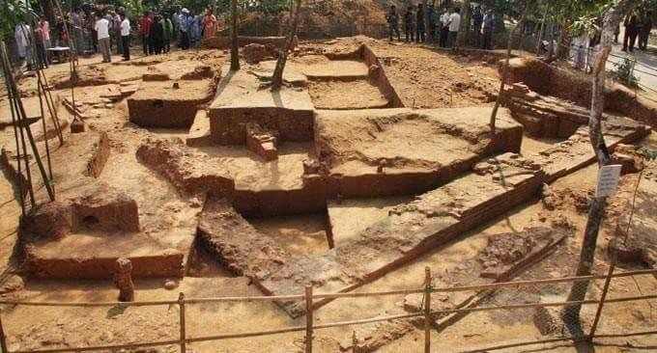

Slide 9
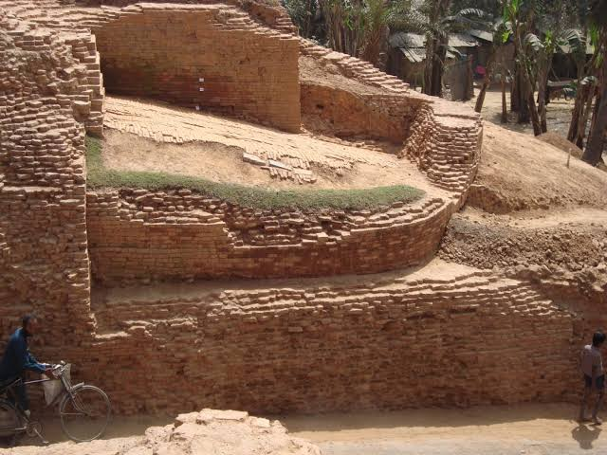

Slide 10
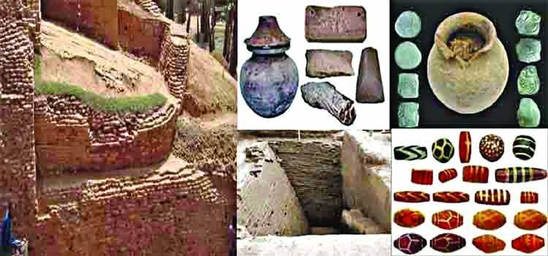

Slide 11
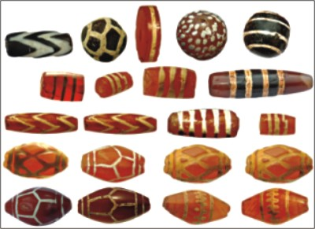

Slide 12
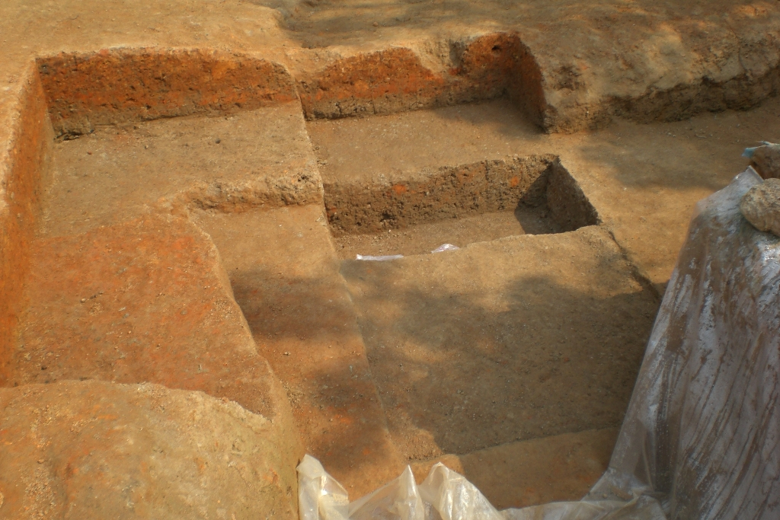
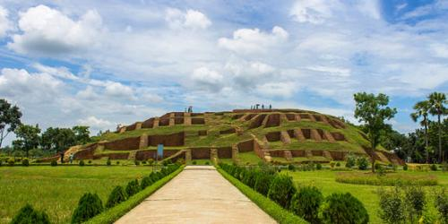

Slide 13
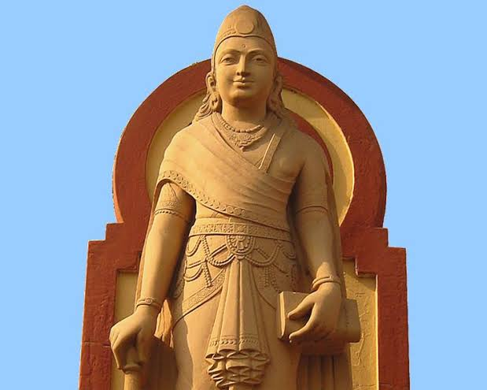
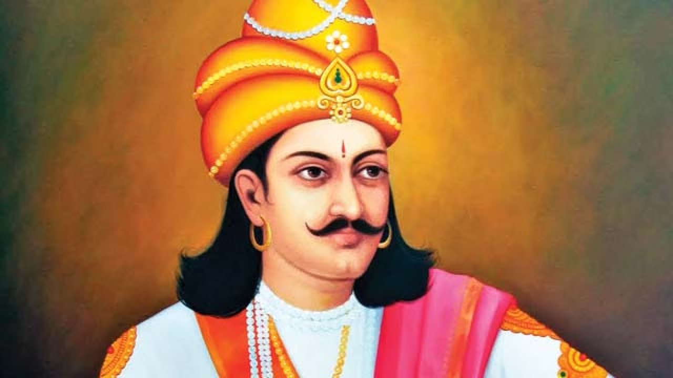
Mauryan empire (322 BCE – 184 BCE)
The Mauryan Empire unified most of the Indian subcontinent into one state for the first time and was one of the largest empires in subcontinental history.
The empire was established by Chandragupta Maurya. The reign of Ashoka ushered an era of social harmony, religious transformation, and expansion of the sciences and of knowledge.
Chandragupta Maurya's embrace of Jainism increased social and religious renewal and reform across his society, while Ashoka's embrace of Buddhism has been said to have been the foundation of the reign of social and political peace and non-violence across the subcontinent.
Ashoka sponsored the spreading of Buddhist missionaries to various parts of Asia.
Bengal's oldest inscription - the Mahasthan Brahmi Inscription - dates from the Mauryan period. The inscription was written in the Brahmi script in the provincial capital of Pundranagara. The inscription was produced during the 3rd century BCE.

Slide 14
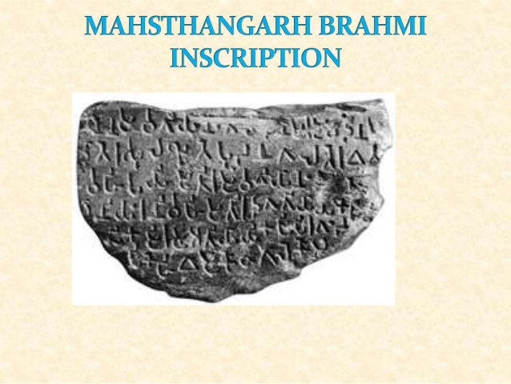

Slide 15
It records an order, issued by some ruler to the Mahamatra stationed at 'Pudanagala' (pundranagara> Mahasthana in Bangladesh) with a view to relieve the distress caused by some agency to the people called Samgvangiyas, who were settled in and about the town.
The inscription speaks of four requisites viz tela (oil), duma (tree), dhanya (paddy) and two varieties of small coins called gandaka (ganda- a unit of calculation consisting of four kapardakas or cowries = one ganda) and Kakanyika (Kakamika-kapardaka or cowry).
The storehouse or golaghar (Kothagala> Kosthagara) had to be filled up with these requisites as provisions against any emergency caused by water, fire and also the devastation of crops by parrots.
The historical importance of the record lies in the fact that it is the earliest evidence that suggests the authority of the Mauryas in the pundravardhana area.

Slide 16
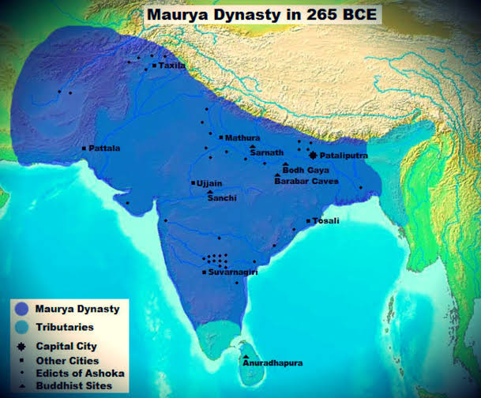

Slide 17
Gupta Empire (319 to 467 CE)
The Gupta Empire is regarded as a golden age in subcontinental history. It was marked by extensive scientific and cultural advancements that crystallized the elements of what is generally known as Hindu culture.
The peace and prosperity created under leadership of Guptas enabled the pursuit of scientific and artistic endeavors in the empire.
Bengal was an important province of the Gupta Empire. The discovery of Gupta era coins across Bengal point to a monetized economy.
Samatața, as a territorial term, has been widely used, beginning with the Allahabad Pillar Inscription of Samudragupta in the 4th century CE, as a frontier state of the Gupta Empire.

Slide 18
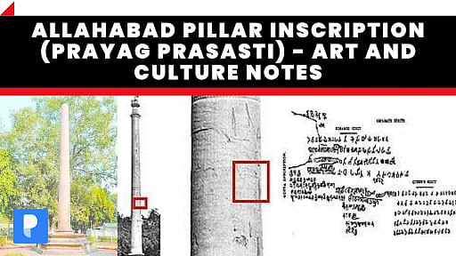

Slide 19
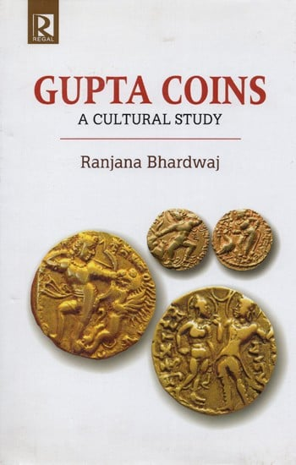
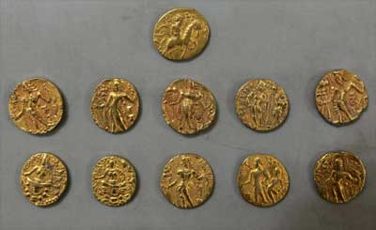

Slide 20
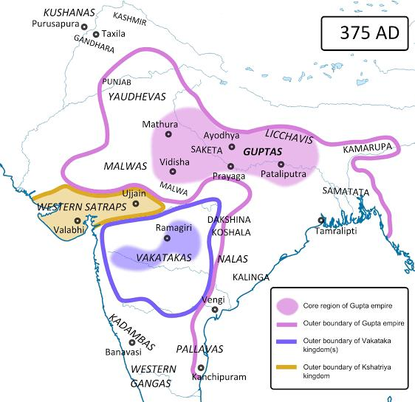

Slide 21
Timeline of Bengal history
Sasanka
590 AD-625 AD
The Pala Dynasty
750 AD-1174 AD
The Deva and Chandra Dynasty
750 AD-1050 AD
The Sena Dynasty
(1097-1225 AD)
The Khalji Dynasty
(1204 AD-1227 AD)
Mamluk Sultanate
1227-1281 AD

Slide 22
Timeline of Bengal History
BALBAN DYNASTY
1281-1324 AD
Ilyas Shahi Dynasty
1342-1414
House of Raja Ganesha
1414-1435
Hussian Shahi Dynasty
(1494-1538 AD)
Habshi Rule in Bengal
1487-1494 AD
Restored Ilyas Shahi Dynasty
1435-1487 AD

Slide 23
Birth of Modern Bangladesh
Suri Empire
1532-1555
Karrani Empire
1564-1576
Mughal Empire
1576-1757 AD
British Period-1757-1947
Pakistan Period
1947-1971

Slide 24
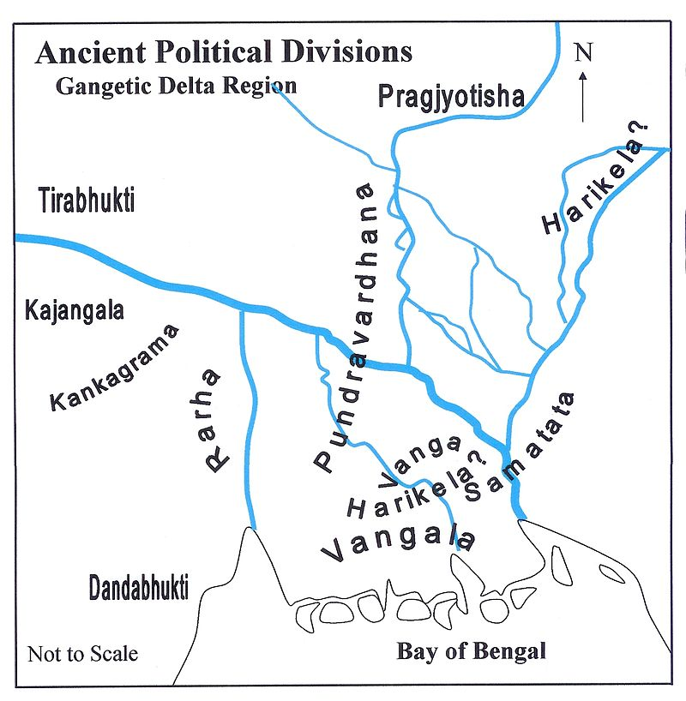

Slide 25
Shasanka, the First Independent Ruler 590 CE - 625 CE
By the beginning of the seventh century shashanka captured power in Gauda. Magadha formed a part of his dominions.
There can hardly be a dispute in regarding him the first important king of Bengal, who could launch Bengal for the first time in her history on aggressive endeavors to establish supremacy over northern India.
In this sense he was the forerunner of the aggressive northern Indian policy of the later day Pala rulers like dharmapala and devapala. His capital was at karnasuvarna.

Slide 26
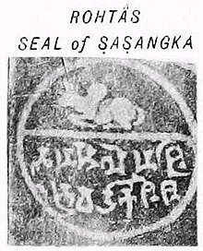

Slide 27
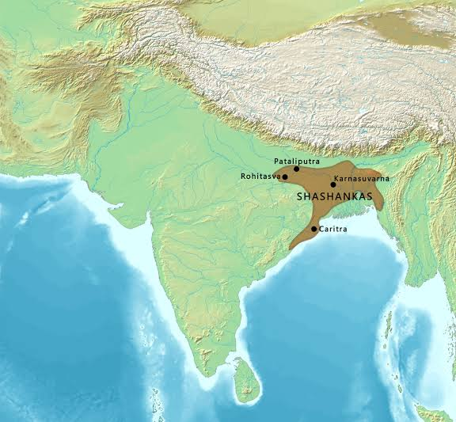

Slide 28


Slide 29
Matsyanyayam the condition of Bengal in the century following the death of Shasanka and before the rise of the Palas (c 750-850 AD) has been described as matsyanyayam (matsyanyayam).
In a near contemporary inscription, the Khalimpur copperplate of the 32nd year of the second Pala ruler dharmapala, and the 12th century ramacharitam kavya of Sandhyakaranandi the anarchical condition of Bengal preceding the rise of the Pala dynasty is found mentioned as matsyanyayam.
The Sanskrit term matsyanyayam, used in ancient texts, bears special significance. The Kautilya Arthaxastra (1.4.13-14) defines the term as follows: ‘When the law of punishment is kept in abeyance, it gives rise to such disorder as is implied in the proverb of fishes, ie, the larger fish swallows a smaller one, for in the absence of a magistrate, the strong will swallow the weak.’

Slide 30
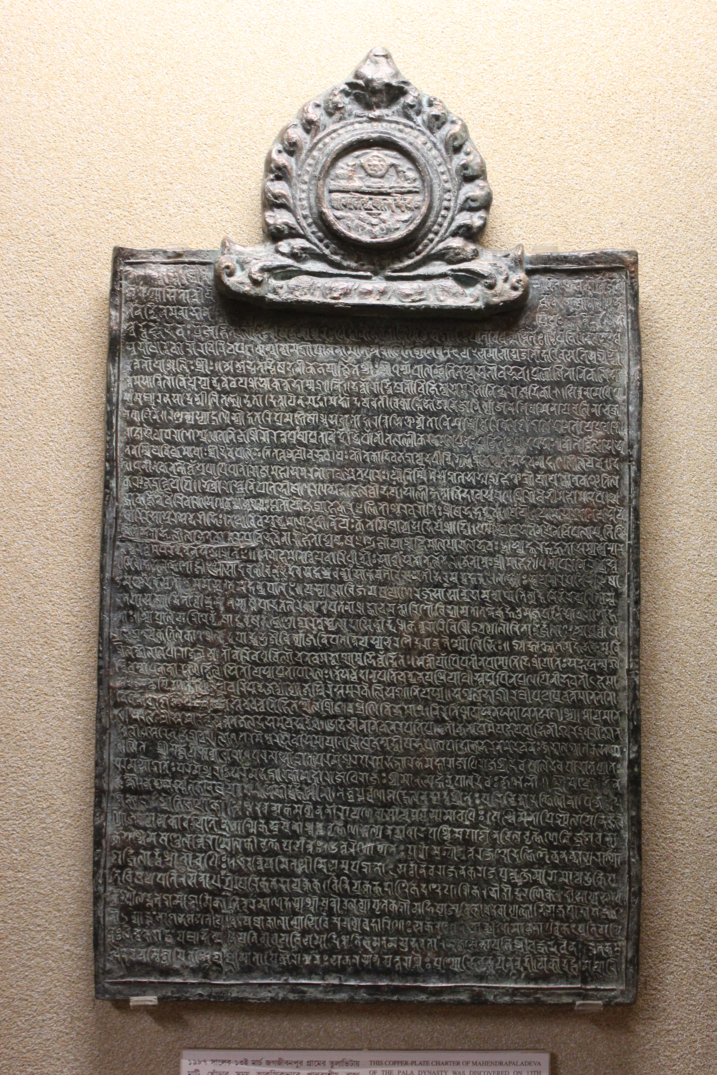

Slide 31
Lama Taranatha, the 17th century Tibetan historian of Buddhism in India, also mentions that all of Bengal was pervaded by an unprecedented anarchy in the century before the rise of the Palas. Government was fragmented, with no king having real control over gauda, vanga or samatata. Ksatriyas, Brahmanas, merchants and townsmen all were kings in their own homes.
The sufferings and strife of the common people were intolerable. The writer of the Manjusrimulakalpa declared that after Shashanka the state of Gauda was paralysed, and whoever was king thereafter would not be able to rule for even a year. According to the same source there was a disastrous famine in the period in the eastern region of India.

Slide 32
From the above it appears clear that in the century following the reign of Shashanka Bengal saw very little of stable government. The country was torn into many small kingdoms and internecine warfare among them caused the instability. In the absence of a strong force capable of enforcing law and order, a situation prevailed that has been termed as matsyanyayam. Physical strength was the only strength, and throughout the land ran the frenzy of unbridled, unruly might.
In order to put an end to this state of affair, Gopala emerged as the king of Bengal and founded the rule of the pala dynasty. We have no direct evidence from which to discern the social ramifications of this anarchy. But indirect deductions from the available evidence makes it clear that in the absence of peace and order there was a decline in trade and commerce.
In the absence of a strong king, the feudal vassals, each one independent and autonomous, must have been instrumental in creating anarchy. And the sagacity of a few of them must have brought an end to the state of lawlessness; some of them coming together brought Gopala to power.

Slide 33
দেশে বহুদিন যাবৎ অরাজকতার ফলে দুঃখকষ্টের সীমা ছিল না। নেতৃস্থানীয় ব্যক্তিরা মিলিত হয়ে সুশৃঙ্খল শাসন প্রতিষ্ঠার জন্য একজন রাজা নির্বাচন করেন।রাত্রে রাজাকে এক কুৎসিত নাগরাক্ষসী হত্যা করে। এভাবে প্রত্যেক রাতেই নতুন নতুন নির্বাচিত রাজাগণ নিহত হতে থাকেন। এভাবে কিছু বছর অতিবাহিত হয়। অবশেষে একদিন সকালে এক বাড়িতে সবাই বিষণ্ণ বসে ছিল। কারণ ঐ বাড়িরই এক ছেলে সকালে রাজা নির্বাচিত হয়েছে। আজ রাতে নাগরাক্ষসী তাকে হত্যা করবে ভেবে সবাই বিষণ্ণ ছিল। কিন্তু সেখানে এক আগন্তুক আসে। সে ঐ ছেলের পরিবর্তে রাজা হতে সম্মত হয়। সেই রাতে লাঠির আঘাতে নাগরাক্ষসীকে সে হত্যা করে। সকালবেলা আগন্তুককে জীবিত দেখে সবাই অবাক হয়ে যায়। তারপর সাতবার এভাবে তিনি রাজা নির্বাচিত হন। তাঁকে স্থায়ী রাজা রূপে অভিষিক্ত করা হয় এবং নাম দেওয়া হয় গোপাল।

Slide 34
The Pala Dynasty 750 AD-1174 AD
Gopala I (750–770) was its first ruler. He came to power in 750 through an election by local leaders in Gauḍa. Gopala ruled from about 750–770 and consolidated his position by extending his control over all of Bengal.
The Pala dynasty lasted for four centuries and ushered in a period of stability and prosperity in Bengal. They created many temples and works of art as well as supported the important ancient higher-learning institutions of Nalanda and Vikramashila. The Somapura Mahavihara built by Emperor Dharmapala is the greatest Buddhist monastery in the Indian subcontinent.

Slide 35
The empire reached its peak under Emperor Dharmapala (770–810) and Devapala (810–850). Dharmapala extended the empire into the northern parts of the Indian subcontinent.
The death of Devapala in 850 ended the period of supremacy of the Pala dynasty and several independent dynasties and kingdoms emerged during this time. However, Mahipala the reign of the Palas. He recovered control over all of Bengal and expanded the empire.
After Mahipala I the Pala dynasty again saw its decline until Ramapala (1077–1130), the last great ruler of the dynasty, managed to retrieve the position of the dynasty to some extent. He crushed the Varendra Rebellion and tried to extend his empire farther to Kamarupa, Odisha and northern India.

Slide 36
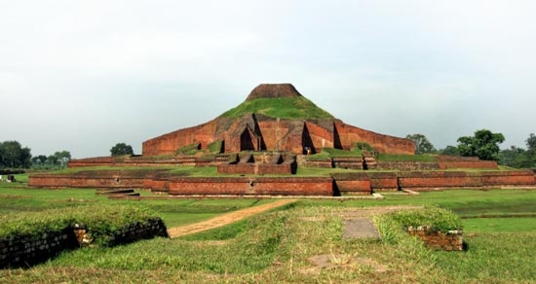

Slide 37
The Pala period is regarded as one of Bengal's golden ages. It was the largest Bengali empire that was known to ancient and classical India. The Palas were responsible for the introduction of Mahayana Buddhism in Tibet, Bhutan and Burma.
It was during the Pala period Bengal became the main center of Buddhist as well as secular learning. Nalanda, Vikramashila and Somapura Mahavihara flourished and prospered under the patronage of the Pala rulers. Dharmapala and Devapala were two great patrons of Buddhism, secular education and culture.
The Palas also had extensive trade as well as influence in Southeast Asia. This can be seen in the sculptures and architectural style of the Sailendra (present-day Malay Peninsula, Java and Sumatra).
While the monarchs were Buddhists, land grants to Brahmin agriculturalists was common.

Slide 38
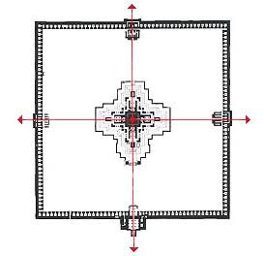

Slide 39
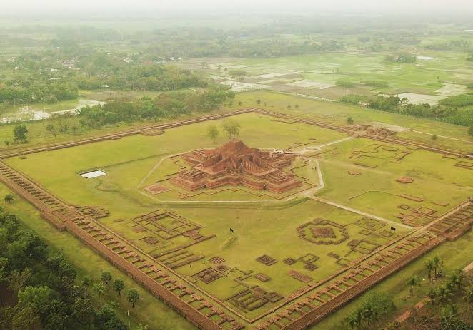

Slide 40
The Chandra and Deva Dynasty 750 AD-1050 AD
The Chandra dynasty ruled southeastern Bengal and Arakan between the 10th and 11th centuries CE. The dynasty was powerful enough to withstand the Pala Empire to the northwest.
The Chandra kingdom covered the Harikela region. The dynasty's kingdom was a bridge between India and Southeast Asia. During this period, the port of Chittagong developed banking and shipping industries.
The last ruler of the Chandra Dynasty, Govindachandra, was defeated by the south Indian Emperor Rajendra Chola I of the maritime Chola dynasty in the 11th century.

Slide 41
The Deva dynasty was a Hindu dynasty of medieval Bengal that ruled over eastern Bengal after the collapse Sena Empire.
The capital of this dynasty was Bikrampur in present-day Munshiganj District of Bangladesh.
The inscriptional evidences show that his kingdom was extended up to the present-day Comilla–Noakhali–Chittagong region.
The Deva dynasty endured after Muslim conquests but eventually died out.

Slide 42
The Sena Dynasty (1097-1225 AD)
The Pala dynasty was replaced by the resurgent Hindu Sena dynasty which hailed from south India. In contrast to the Pala dynasty who championed Buddhism, the Sena dynasty were staunchly Hindu. They brought about a revival of Hinduism and cultivated Sanskrit literature in eastern India.
They succeeded in bringing Bengal under one ruler during the 12th century.
Vijaya Sena, second ruler of the dynasty, defeated the last Pala emperor, Madanapala, and established his reign formally.
Ballala Sena, third ruler of the dynasty, was a scholar and philosopher king. He is said to have invited Brahmins from both south India and north India to settle in Bengal, and aid the resurgence of Hinduism in his kingdom.
The fourth Sena king, Lakshmana Sena, son of Ballala Sena, was the greatest king of his line. He expanded the empire beyond Bengal into Bihar, Assam, Odisha and likely Varanasi. Lakshmana was later defeated by the nomadic Turkic Muslims and fled to eastern Bengal, where he ruled few more years

Slide 43
Medieval and early modern Bengal

Slide 44
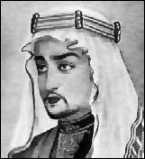
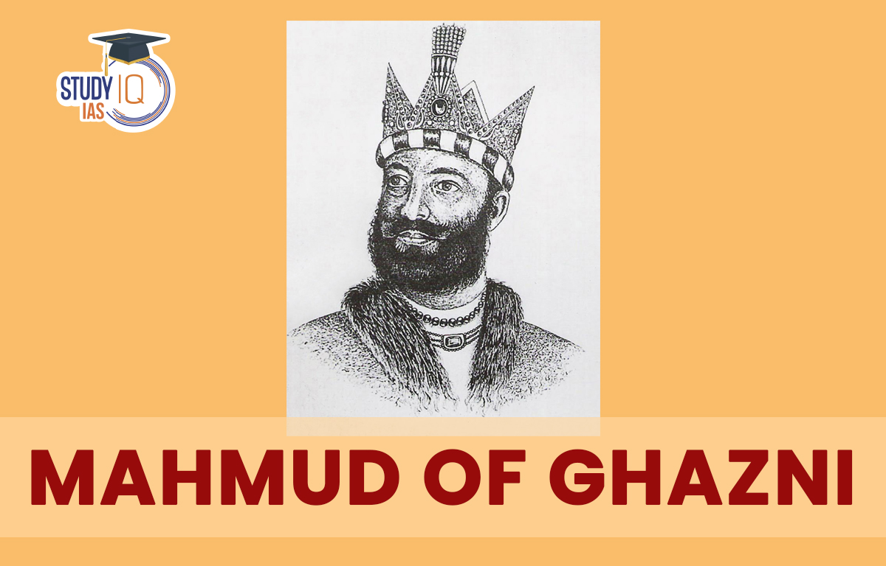
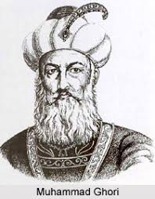
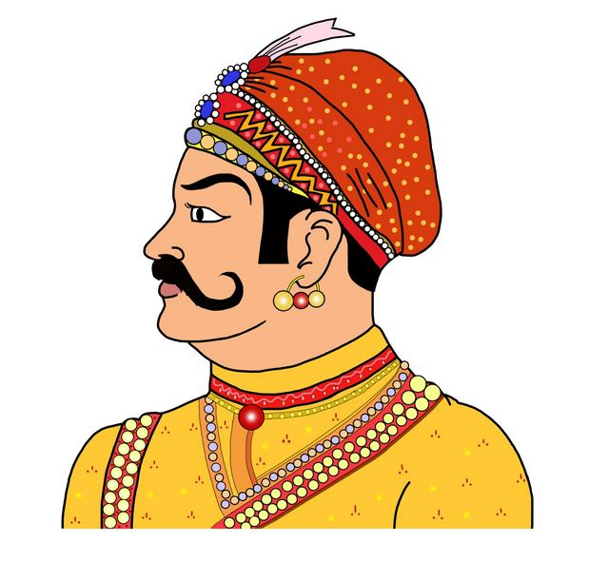
The Advent of Islam
Muhammed Bin Qasim
During the reign of Hajjaj Bin Yousuf, the Governor of Eastern provinces of the Ummayad Caliph Walid bin Abdul Malik, His son-in-law Muhammed Bin Qasim was successful to defeat Dahir in 712, the King of Sindh was killed.
Sultan Mahmud
After the victory over sindh, It was Sultan Mahmud (Sultan of Gaznid) who marched towards subcontinent for 17 times from 1000-1027 AD, 300 years later after the previous one from Qasim.
Muhammad Ghuri
150 Years passed after the death of Sultan Mahmud, Muhammad Ghuri had the title of the Sultan of Ghaznid and finally he brought the Political Islam in India
1st War at Tarain ( Ghuri was defeated by Prithwi Raj in 1191)
2nd War at Tarain (Prithwi Raj was defeated by Ghuri in 1192)

Slide 45

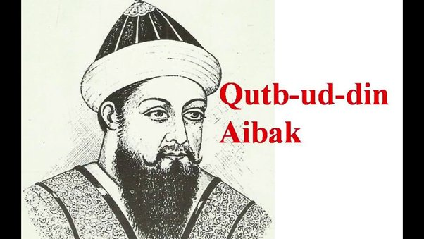
Delhi Sultanate
Slave Dynasty (1206-1210)
1. Qutub Uddin Aibek (1206-1210)- He made Delhi as the center of his rule by getting authority from Ghuri, Qutb Minar was established by him.

Slide 46
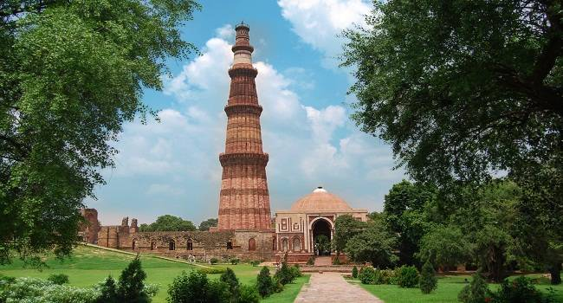
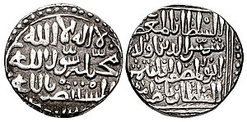
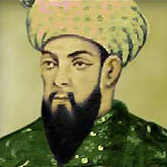
The Real Founder Of Delhi Sultanate
2. Sultan Samsuddin Iltutmish (1211-1236) He was the son-in-law of Aibek, the real founder of Delhi Sultanate, He introduced first Muslim coin and finished the work of Qutb Minar.

Slide 47
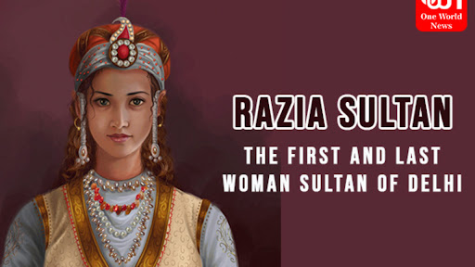
Delhi Sultanate (first women Sultan)
3. Sultana Razia- The daughter of Iltutmish ascended on throne on 1235, he was the first women in subcontinent up to then to hold the executive position.

Slide 48
Delhi Sultanate
4. Sultan Nasiruddin Mahmud (1246-1266)
5. Sultan Ghiyas Uddin Balban (1266-1287)

Slide 49
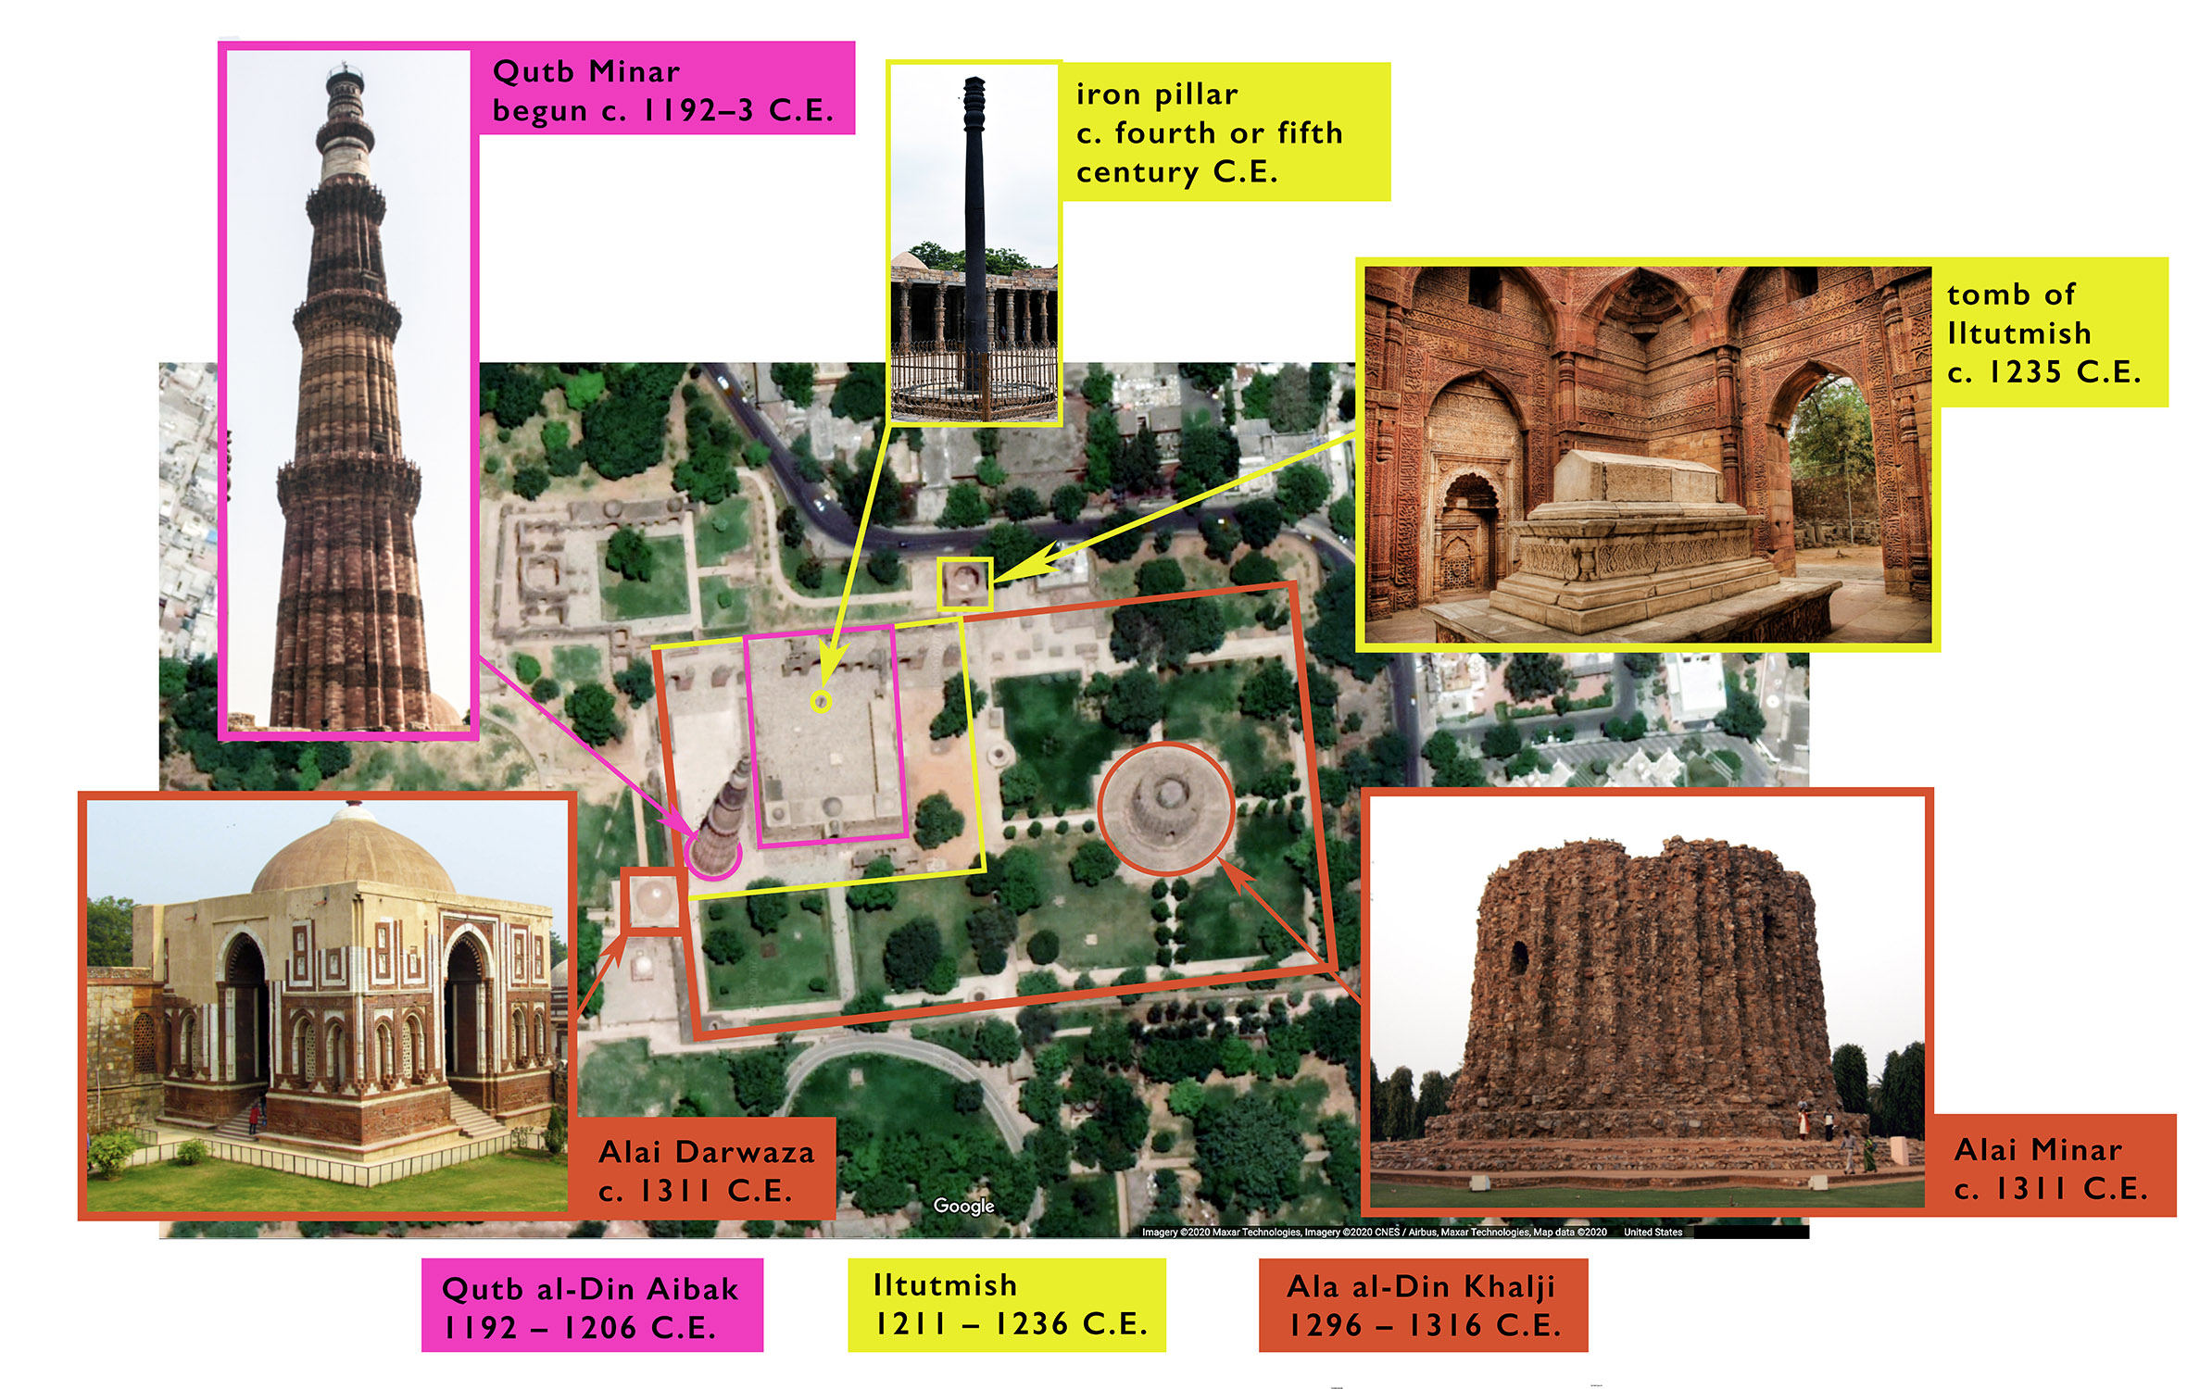

Slide 50
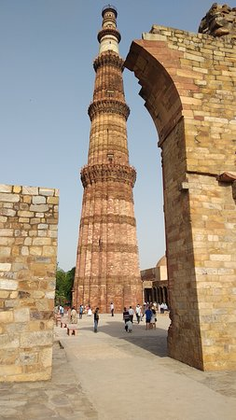

Slide 51
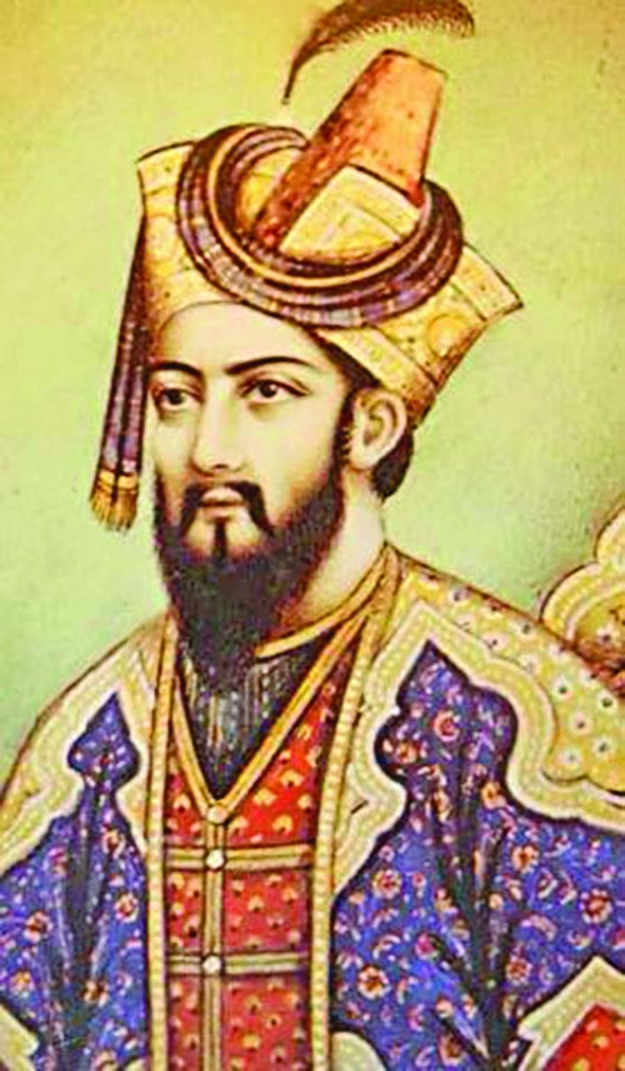
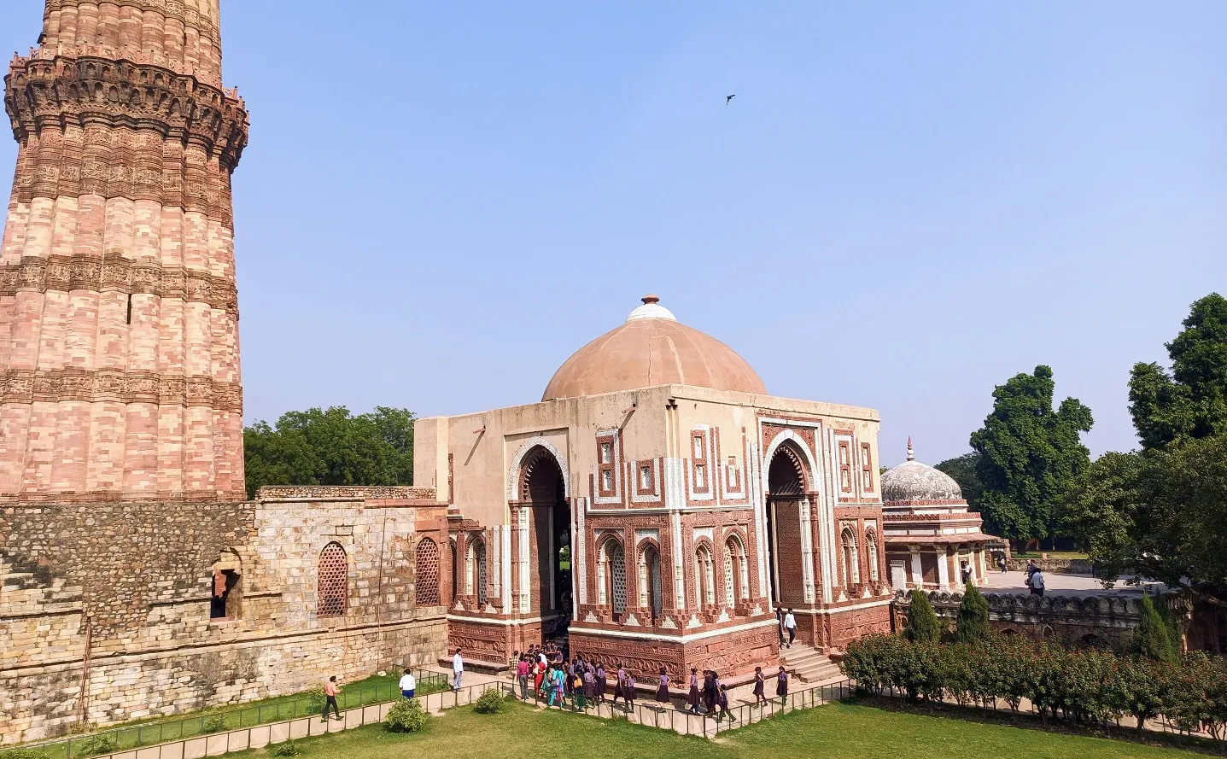
Khilji Dynasty (1290-1320)
1. Alauddin Khilji- He built ‘Alai-Darwaza’

Slide 52
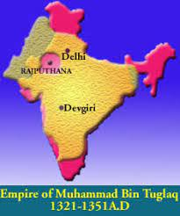
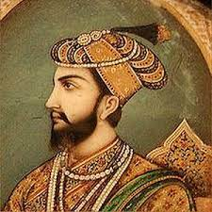
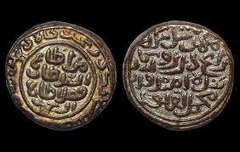
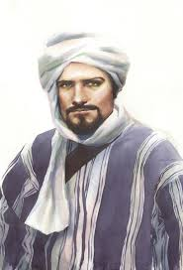
Tughlaq Dynasty (1320-1351)
1. Muhamamad Bin Tughlaq-
Sifted his capital to Debgiri, but soon he had to transfer the capital to Delhi as the royal staff didn’t want to reside there and the attack of Mongal there.
Currency- He introduced new copper currency instead of gold and silver but due to the currency forgery………
Ibn Batuta was in a royal post in his court for 8 years, at last he imprisoned him and lastly forgiven and released him on the condition to go back.

Slide 53
Sayyid Dynasty (c. 1414–51)
Sayyid dynasty, rulers of India's Delhi sultanate (c. 1414–51) as successors of the Tughluq dynasty until displaced by the Afghan Lodīs. This family claimed to be sayyids, or descendants of the Prophet Muhammad.

Slide 54
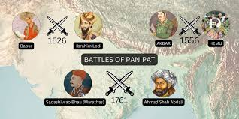
Lodi Dynasty (1451-1526), Last Dynasty of DS
1. In the Battle of Panipath I, Babur defeated the last ruler of Lodi dynasty named ‘Ibrahim Lodi’ and founded the Mughal empire in india in 1526.

Slide 55
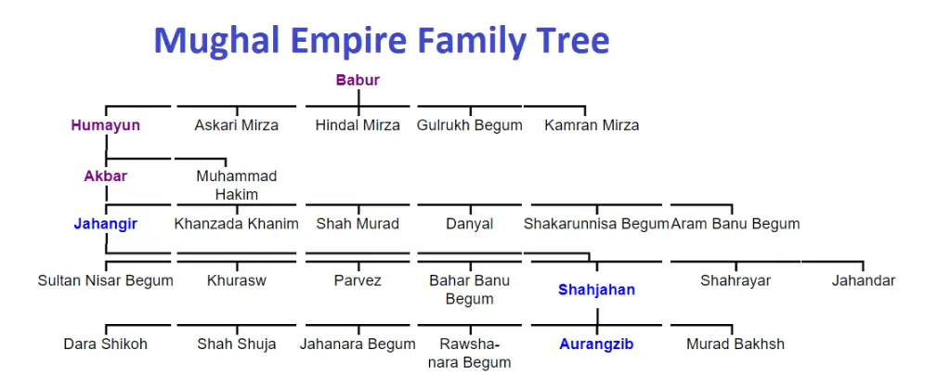

Slide 56
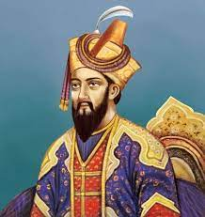
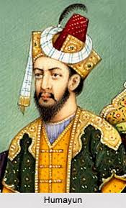
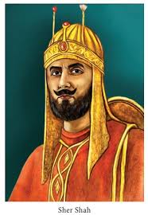
Mughal Dynasty (First Phase) (1526-1539)
1. Jahiruddin Muhammad Babur (1526-1530)- the founder of Mughal dynasty and the writer of ‘Tuzk-i-Babr’.
2. Nasiruddin Muhammad Humayun (1530-1540)- He was the eldest son of Babur, in 1538 he paid a visit to Bengal and named Bengal as ‘Jannatabad’. He was defeted by Sher Shah in the Battle of Chausar in 1539 and fled to persia.

Slide 57
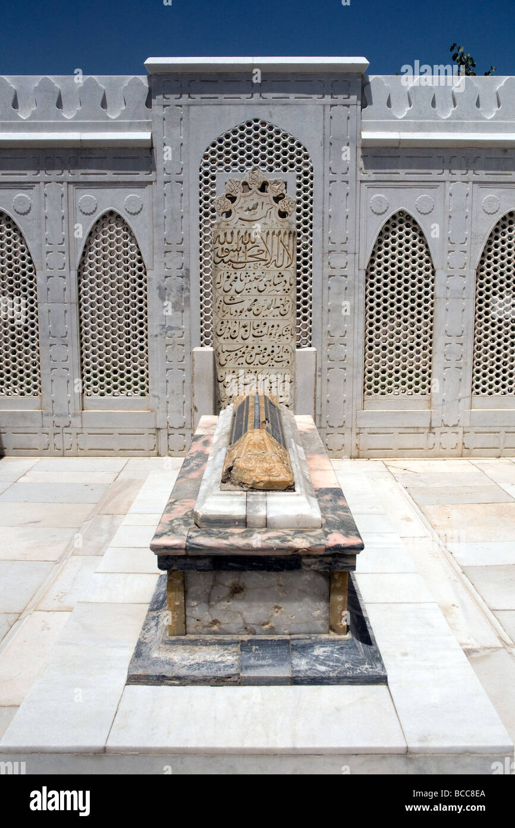
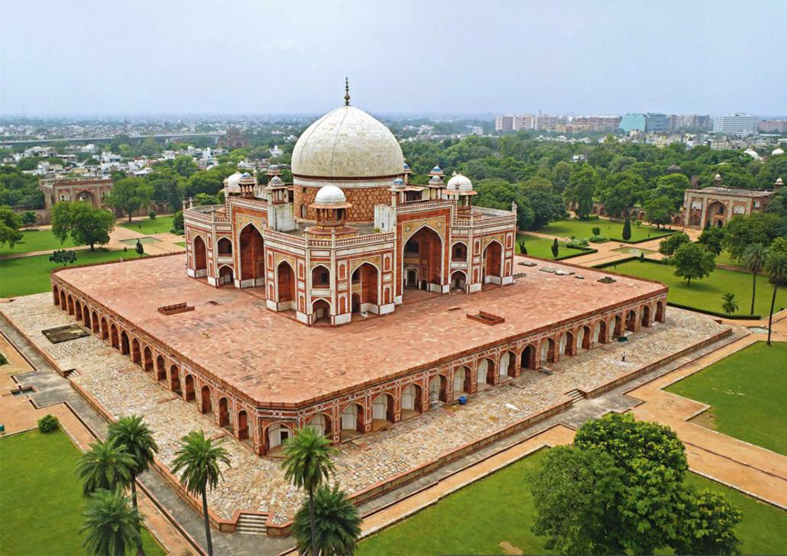

Slide 58
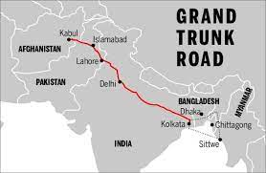
Shur Dynasty (1539-1555)
1. Sher Shah- Grand Trunk Road (4830 KM)- extended from Sonargaon to Lahore, Postal System, Kabuliyat (deed to govt) and Patta (from Govt)

Slide 59
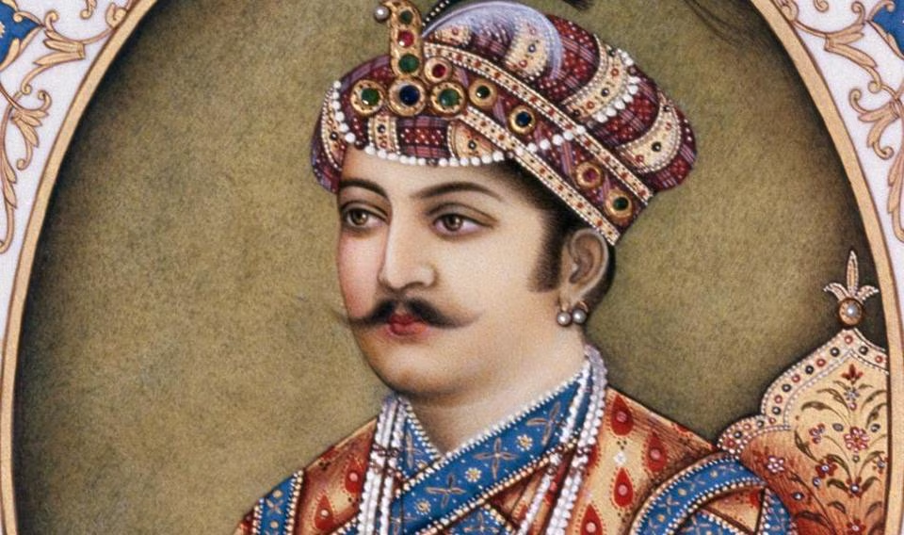
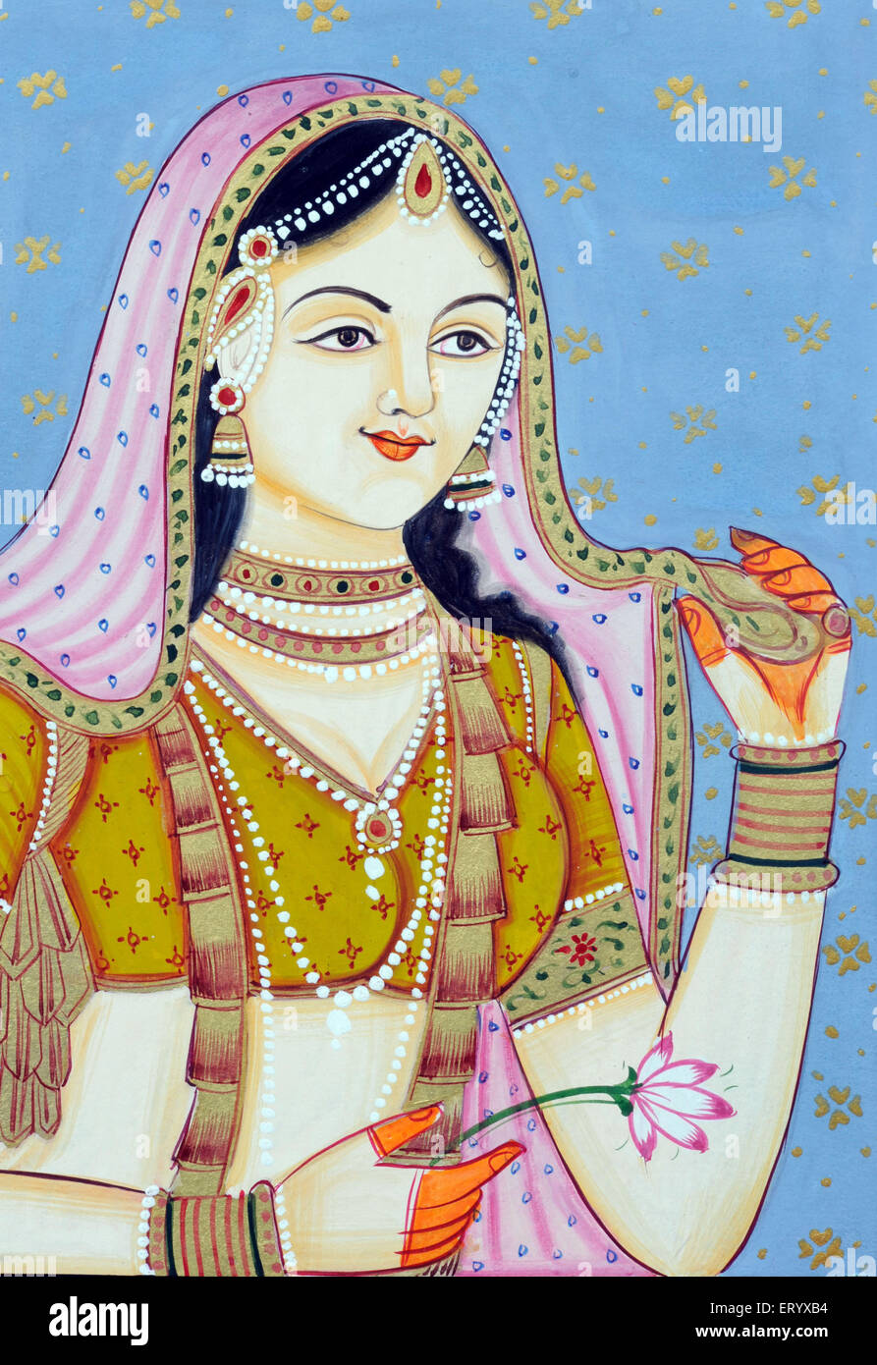
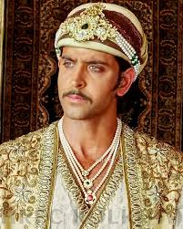

Restored Mughal Dynasty (2nd Phase) (1555-1707)
Humayun- Humayun restored his title from the Shurs in 1555 by the help of Persian ruler and died in 1556.
3. Jalal uddin Muhammad Akbar (1556-1605)- At the age of only 13, he ascended on the throne, the great Akbar for his liberal policy. He repealed Zizya tax, married Jodhabai, the daughter of the rajputna and appointed a number of rajputna in the higher administration. Finally he introduced Din-e-Ilahi. Baro Bhuiyans were evolved in Benbal during his reign and Bengal was known as ‘Subah-i-Bengala’.

Slide 60


Restored Mughal Dynasty (2nd Phase) (1555-1707)
4. Nur Uddin Muhammad Jahangir [BP] (1605-1627)- He introduced persian as official language and consolidated the political and military authority over Bengal for the very first time.

Slide 61


Restored Mughal Dynasty (2nd Phase) (1555-1707)
5. Shah Jahan (1628-1658)- Prince of builders- Diwan-i-Aam, Diwan-i-Khass, Shalimar Uddyan, Taj Mahal, Kohinoor, Lal Qila, and Jam-e-Masjid.

Slide 62


Slide 63


Slide 64




Slide 65

Last Strong Mughal Ruler
Aurangzeb (1658-1707)- He followed Shariah in operating the empire, is considered by liberal scholars as an extremist ruler because he reintroduced the Jizya tax .

Slide 66

The Establishment of Muslim Rule In Bengal 1204-1338 (Balbani Era)
In 1204, Ikhtiyar Uddin Muhammad Bin Bakhtiyar Khilji (Commonly known as Bakhtiyar Khilji) defeated Laxman Sena, the last Sena ruler and made ‘Devcote’ of Dinajpur as his capital
Turkey Rule in Bengali- From 1204-1338 (Balbani Era), a number of governors nominated by Delhi (Mamluk, Khilji, Tughlaq) ruled Bengal. Soon after their take over, they (most of them) tried to be an Independent ruler but the central government was successful to suppress them. Hence Bengal was named as ‘Bulgakhpur’.

Slide 67

Iliyas Shahi Dynasty (1342-1412)
1. Fakhruddin Mubarak Shah sultan of Bengal (1338-1349). He was the founder of the earliest independent Muslim sultanate in Bengal with his headquarters at the historic city of Sonargaon.
2. Sultan Shamsuddin Iliyas Shah (1342-1357)- He had taken the control of all Bengal and taken the title of ‘Shah-i-Bangalah’. He transferred his capital from Gauda to Pandua. He was the real founder of Independent Bengal,
3. Ghiyas Uddin Azamshah- Yousuf Zulekha, he had a good tie with Hafeez.

Slide 68


House of Raja Ganesha (1414-1435)
Raja Ganesha a Hindu landlord of Bhaturia and Dinajpur. Ganesha became the king of Bengal by taking power from the weak Iliyas Shahi sultans in the early 15th century (1414).
Jalaluddin Muhammad Shah Alias Jadunarayan (1415-1416) – (1418-1433)

Slide 69
Restored Ilyas Shahi Dynasty 1435-1487 AD

Slide 70


Habshi Rule in Bengal 1487-1494 AD
The "Habshi Rule" in Bengal refers to a brief period between 1487 and 1494 AD when a series of African rulers, known as Habshis (Ethiopians), held power in the Bengal Sultanate, following the assassination of the last Ilyas Shahi ruler and seizing control through a palace eunuch named Shahzada Barbak Shah; this period was marked by instability and frequent changes in leadership.

Slide 71


Slide 72

Hussain Shahi Dynasty (1493-1538)
1. Alauddin Hussain Shah- He was the greatest ruler of Bengali Independent Sultans, During this period Gauda was the capital of Bengal. Shree Chaitanya preached his ‘Bhaisnavism’ by this time. ‘Mahabharata’ was translated in Bengali by this time by Kabindra Parameshwar and Srikar Nandi. Chota Sona Masjid of Gauda was built by him and Biprodas, Bijoy Gupta, Jasoraj Khan were sponsored by him.
2. Ghiyas Uddin Mahmud Shah- He was the last Independent Sultan of Bengal. Sher Shah defeated him in 1538 and captured the capital ‘Gauda’.

Slide 73
Birth of Modern Bangladesh
Suri Empire
1532-1555
Karrani Empire
1564-1576
Mughal Empire
1576-1757 AD
British Period-1757-1947
Pakistan Period
1947-1971

Slide 74



The Baro-Bhuiyans
Akbar failed to subjugate whole of Bengal as many Zaminders having strong army were ruling different regions independently and they were united to suppress Mughal expedition. They are known as ‘Baro-Bhuiyans’
Isha Khan of Sonargaon was the leader of the Baro Bhuiyans, after his natural death, Musa Khan became the leader and Jahangir was in the Mughal throne. It was Islam khan who was appointed by Jahangir as the Subedar was successful to defeat the Baro bhuiyans.
Pratapaditya was an influential Zaminders among the Baro Bhuiyans

Slide 75
Bengal Under the Mughal
Mughal Emperor | Subedar of Bengal | Notable activities
Emperor Jahangir (1605-1627) | Islam Khan (1608-1613) | Suppressed the Baro Bhuiyans Made Dhaka as the capital in 1610 and Named it as ‘Jahangirnagar’ He excavated the ‘Dholai Khal’
Emperor Shah Jahan | Qasim Khan (1628-1632) Shah Suja | The portuguese were uprooted from Hoogli The right to trade in Bengal without duty Builded ‘Borokara’ In 1633, EIC got the right to involve in the Bengal trade and commerce and to establish a fort
Emperor Auranzeb (1658-1707) | Mir Jumla (1660-1663) Shayesta Khan (1664-1678) and (1679-16880 | SK captured Chittagong and Sandeep from the Mogh and Potuguese pirates SK-Chota Katra, Lalbagh Killa, Chak Masjid, Shat Gambuj

Slide 76
The Rule of Nawabs in Bengal
Nawab Murshid Quli Khan (1717-1727)- During this time, Bengal was again became independent as the control of central authority became weakened. He transferred capital to Rajmahal from Dhaka.
Nawab Alibardi Khan (1740-1756)
Nawab Siraj-ud-Daula (1756-1757)
&
The Battle of Palassey
Nawab Mir Jafar Ali (1757-1760)
Nawab Mir Qasim (1760-1764)
&
The Battle of Buxer

